Slide 1
2023 IN REVIEW

Slide 2
16

Slide 3
16

Slide 4
ORGANIZATIONAL MILESTONES
ADDED ONE NEW COUNTY

Slide 5
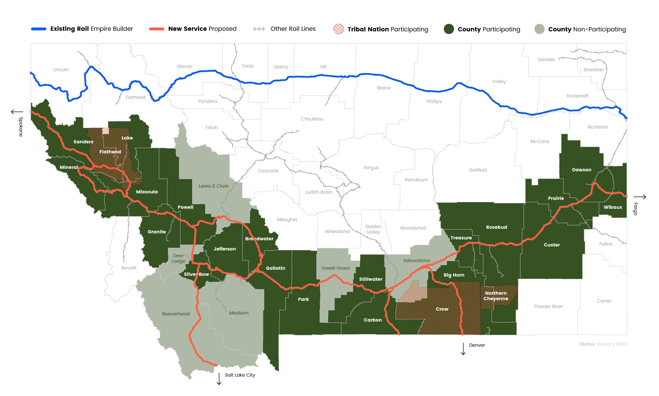
20 MEMBER COUNTIES
Notes:
5

Slide 6
ORGANIZATIONAL MILESTONES
ADDED ONE NEW COUNTY
HIRED EXECUTIVE MANAGEMENT
SHIFTED ADMINISTRATIVE SUPPORT TO WSS
OPENED BILLINGS OFFICE

Slide 7
ORGANIZATIONAL MILESTONES
ADDED ONE NEW COUNTY
HIRED EXECUTIVE MANAGEMENT
SHIFTED ADMINISTRATIVE SUPPORT TO WSS
OPENED BILLINGS OFFICE
HELD ANNUAL MEETING IN BUTTE

Slide 8
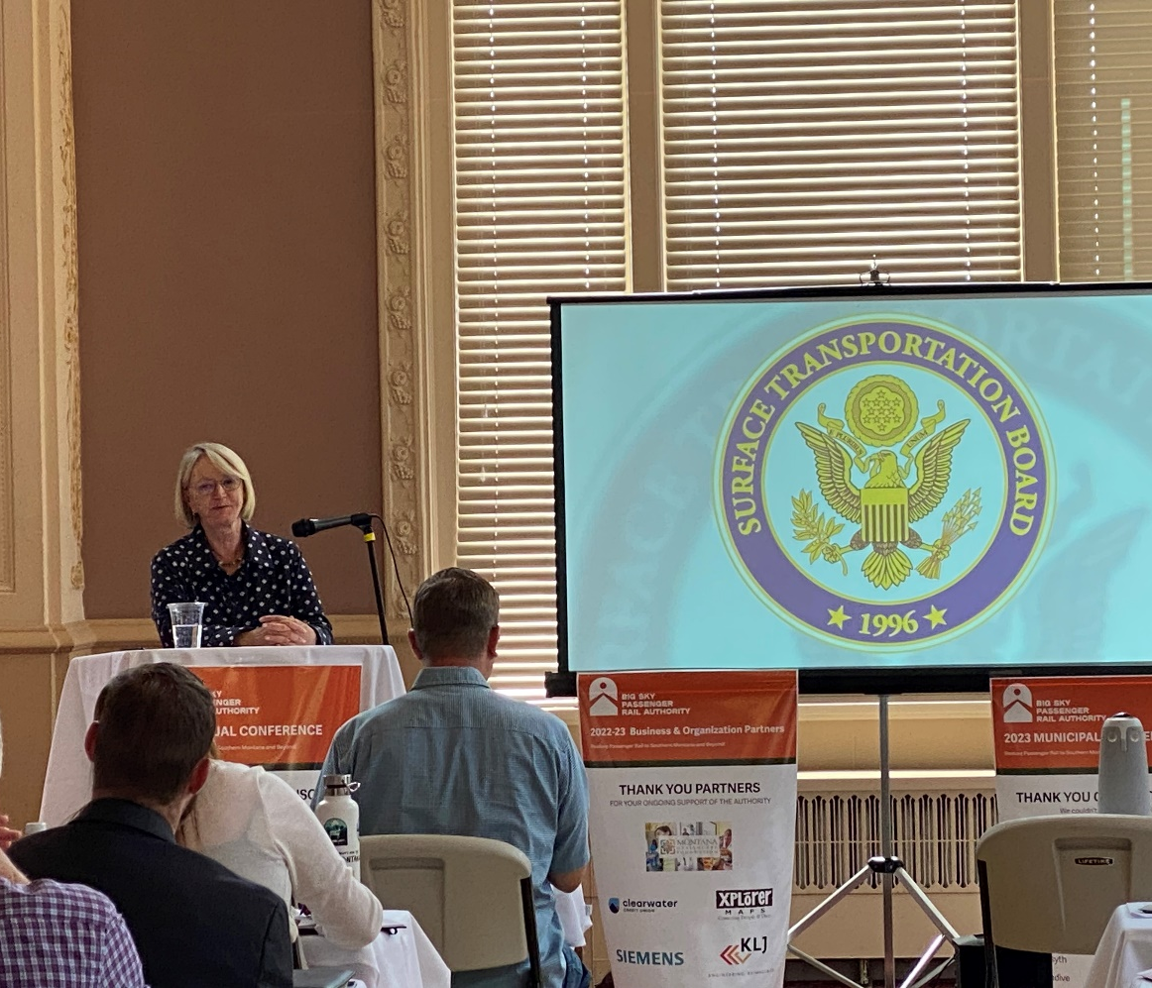
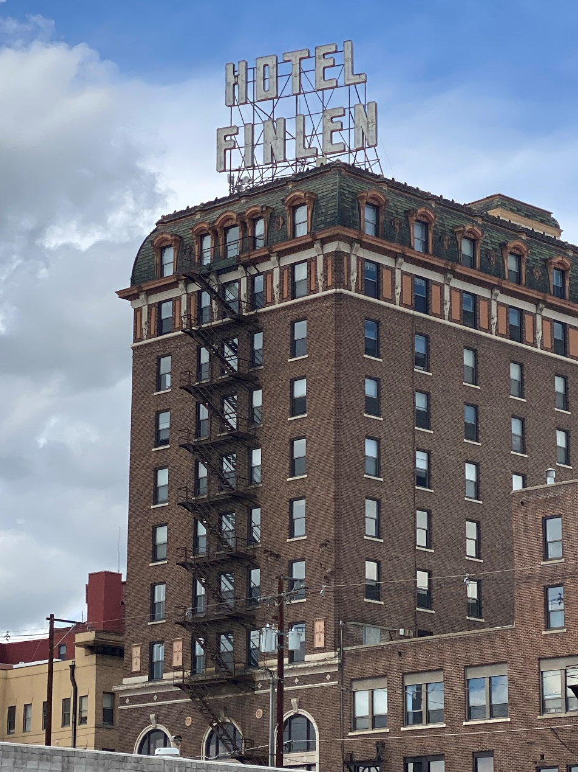
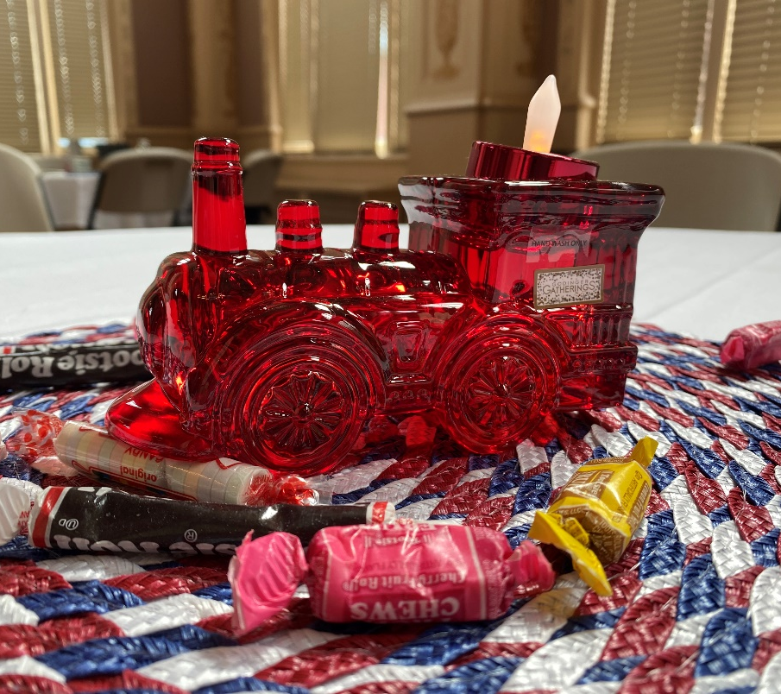
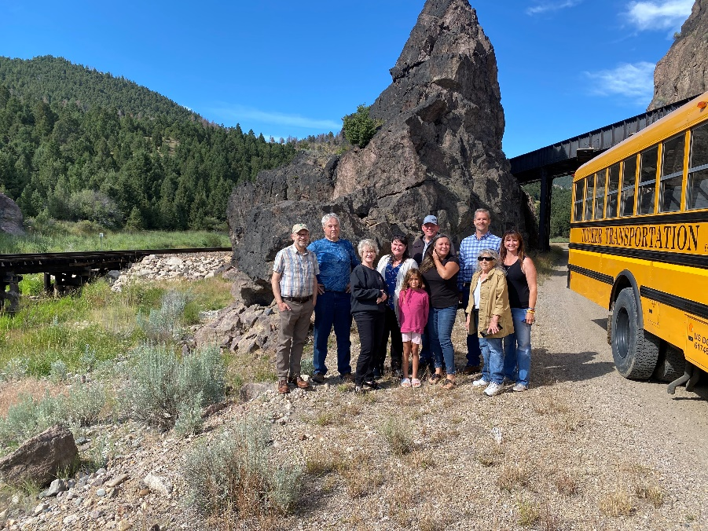

Slide 9
ORGANIZATIONAL MILESTONES
ADDED ONE NEW COUNTY
CHAIR APPOINTED TO AASHTO-CORT
HIRED EXECUTIVE MANAGEMENT
SHIFTED ADMINISTRATIVE SUPPORT TO WSS
OPENED BILLINGS OFFICE
HELD ANNUAL MEETING IN BUTTE

Slide 10
ORGANIZATIONAL MILESTONES
ADDED ONE NEW COUNTY
CHAIR APPOINTED TO AASHTO-CORT
HIRED EXECUTIVE MANAGEMENT
PUBLISHED FIRST ANNUAL REPORT
SHIFTED ADMINISTRATIVE SUPPORT TO WSS
OPENED BILLINGS OFFICE
HELD ANNUAL MEETING IN BUTTE

Slide 11
ORGANIZATIONAL MILESTONES
ADDED ONE NEW COUNTY
CHAIR APPOINTED TO AASHTO-CORT
HIRED EXECUTIVE MANAGEMENT
PUBLISHED FIRST ANNUAL REPORT
SHIFTED ADMINISTRATIVE SUPPORT TO WSS
BEGAN UPDATING RULES OF PROCEDURE/BSPRA MANUAL
OPENED BILLINGS OFFICE
HELD ANNUAL MEETING IN BUTTE

Slide 12
ORGANIZATIONAL MILESTONES
ADDED ONE NEW COUNTY
CHAIR APPOINTED TO AASHTO-CORT
HIRED EXECUTIVE MANAGEMENT
PUBLISHED FIRST ANNUAL REPORT
SHIFTED ADMINISTRATIVE SUPPORT TO WSS
BEGAN UPDATING RULES OF PROCEDURE/BSPRA MANUAL
OPENED BILLINGS OFFICE
ADOPTED PROCURMENT POLICY
HELD ANNUAL MEETING IN BUTTE

Slide 13
ORGANIZATIONAL MILESTONES
ADDED ONE NEW COUNTY
CHAIR APPOINTED TO AASHTO-CORT
HIRED EXECUTIVE MANAGEMENT
PUBLISHED FIRST ANNUAL REPORT
SHIFTED ADMINISTRATIVE SUPPORT TO WSS
BEGAN UPDATING RULES OF PROCEDURE/BSPRA MANUAL
OPENED BILLINGS OFFICE
ADOPTED PROCURMENT POLICY
HELD ANNUAL MEETING IN BUTTE
PINT NIGHTS IN PHILIPSBURG, BILLINGS, AND MILES CITY

Slide 14
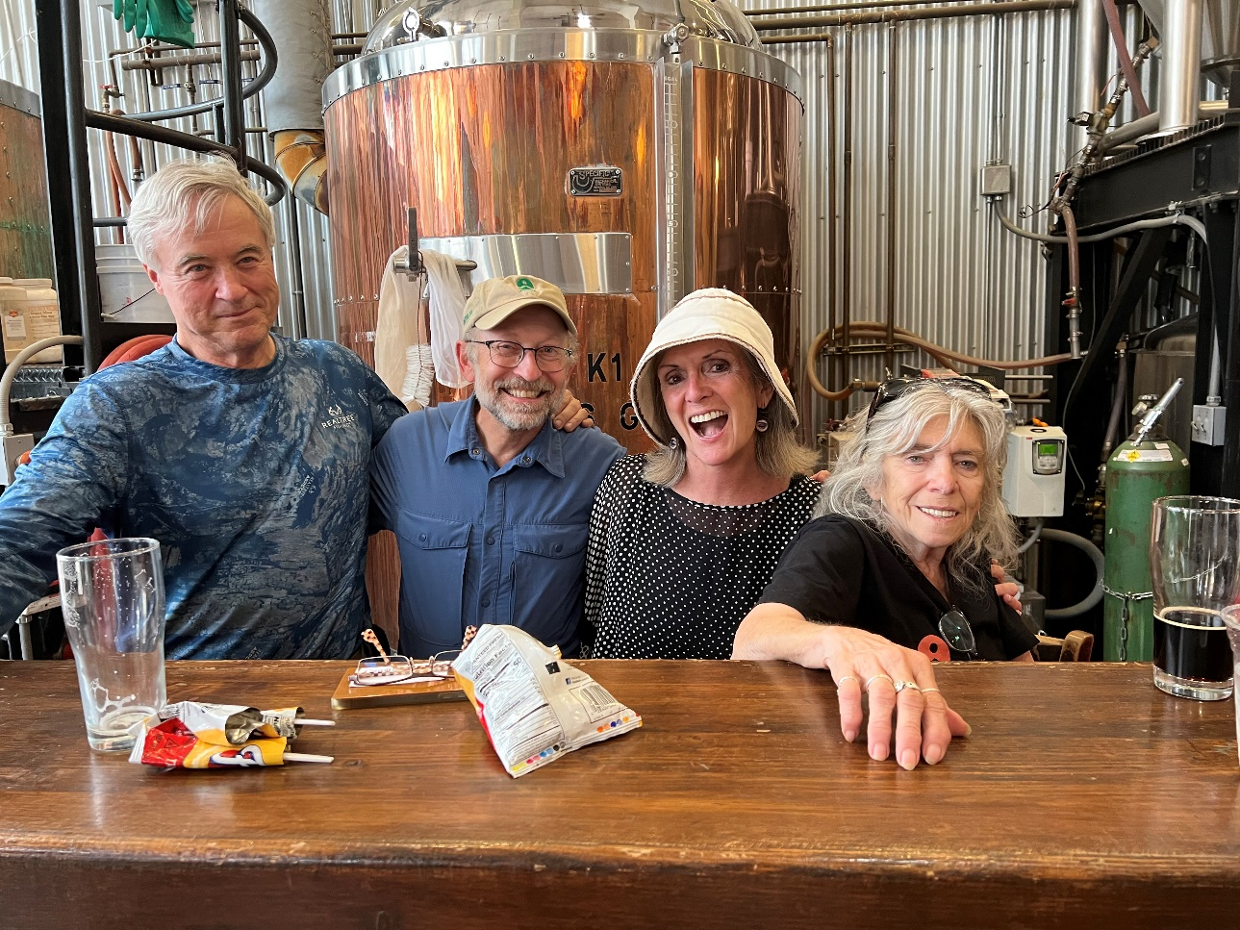
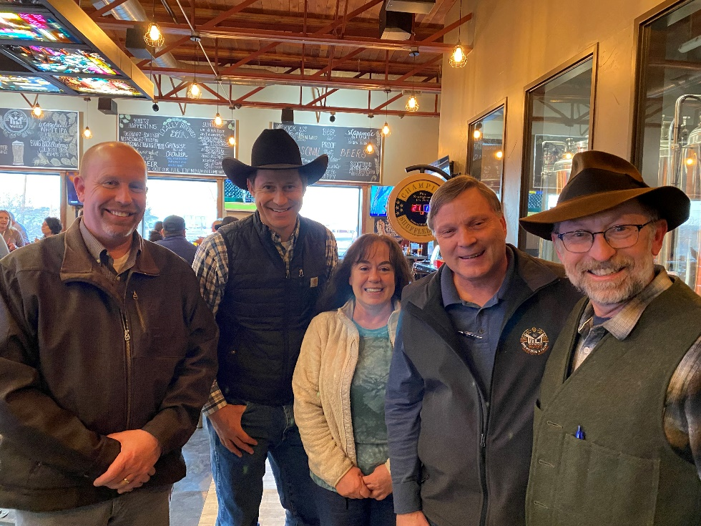

Slide 15
PROGRMATIC MILESTONES
PARTICIPATED IN LONG-DISTANCE STUDY WORKSHOPS

Slide 16
PROGRMATIC MILESTONES
PARTICIPATED IN LONG-DISTANCE STUDY WORKSHOPS
AWARDED $25K BY THE MONTANA HEALTHCARE FOUNDATION
CONDUCTED 6 COMMUNITY ENGAGEMENT MEETINGS

Slide 17
PROGRMATIC MILESTONES
PARTICIPATED IN LONG-DISTANCE STUDY WORKSHOPS
AWARDED $25K BY THE MONTANA HEALTHCARE FOUNDATION
CONDUCTED 6 COMMUNITY ENGAGEMENT MEETINGS
APPLIED FOR THE CORRIDOR ID AND DEVELOPMENT PROGRAM

Slide 18
PROGRMATIC MILESTONES
PARTICIPATED IN LONG-DISTANCE STUDY WORKSHOPS
AWARDED $25K BY THE MONTANA HEALTHCARE FOUNDATION
CONDUCTED 6 COMMUNITY ENGAGEMENT MEETINGS
APPLIED FOR THE CORRIDOR ID AND DEVELOPMENT PROGRAM
CO-APPLICANT WITH AMTRAK FOR FED-STATE PARTNERSHIP

Slide 19
PROGRMATIC MILESTONES
PARTICIPATED IN LONG-DISTANCE STUDY WORKSHOPS
ACCEPTED INTO CORRIDOR ID!
AWARDED $25K BY THE MONTANA HEALTHCARE FOUNDATION
CONDUCTED 6 COMMUNITY ENGAGEMENT MEETINGS
APPLIED FOR THE CORRIDOR ID AND DEVELOPMENT PROGRAM
CO-APPLICANT WITH AMTRAK FOR FED-STATE PARTNERSHIP

Slide 20
PROGRMATIC MILESTONES
PARTICIPATED IN LONG-DISTANCE STUDY WORKSHOPS
ACCEPTED INTO CORRIDOR ID!
AWARDED $25K BY THE MONTANA HEALTHCARE FOUNDATION
AWARDED $14.9 MILLION FOR RAIL IMPROVEMENTS NEAR MALTA
CONDUCTED 6 COMMUNITY ENGAGEMENT MEETINGS
APPLIED FOR THE CORRIDOR ID AND DEVELOPMENT PROGRAM
CO-APPLICANT WITH AMTRAK FOR FED-STATE PARTNERSHIP

Slide 21
PROGRMATIC MILESTONES
PARTICIPATED IN LONG-DISTANCE STUDY WORKSHOPS
ACCEPTED INTO CORRIDOR ID!
AWARDED $25K BY THE MONTANA HEALTHCARE FOUNDATION
AWARDED $14.9 MILLION FOR RAIL IMPROVEMENTS NEAR MALTA
CONDUCTED 6 COMMUNITY ENGAGEMENT MEETINGS
KICKED OFF CORRIDOR ID IN JANUARY, 2024
APPLIED FOR THE CORRIDOR ID AND DEVELOPMENT PROGRAM
CO-APPLICANT WITH AMTRAK FOR FED-STATE PARTNERSHIP

Slide 22
PROGRMATIC MILESTONES
PARTICIPATED IN LONG-DISTANCE STUDY WORKSHOPS
ACCEPTED INTO CORRIDOR ID!
AWARDED $25K BY THE MONTANA HEALTHCARE FOUNDATION
AWARDED $14.9 MILLION FOR RAIL IMPROVEMENTS NEAR MALTA
CONDUCTED 6 COMMUNITY ENGAGEMENT MEETINGS
KICKED OFF CORRIDOR ID IN JANUARY, 2024
APPLIED FOR THE CORRIDOR ID AND DEVELOPMENT PROGRAM
CO-APPLICANT WITH AMTRAK FOR FED-STATE PARTNERSHIP

Slide 23
NEXT STEPS FOR THE BSPRA IN 2024
Add additional counties to BSPRA
Add additional municipal partners to BSPRA
Enter Corridor ID Program, complete Step 1 and begin Step 2
Encourage Congress to nominate someone from Montana/West to fill a seat on the Amtrak Board of Directors
Support tribal nations, member counties and BNSF with rail enhancements across Montana
Continued engagement with Long-Distance Study

Slide 24
WE CAN DO THIS!

Slide 25
WE CAN DO THIS!

Slide 26
WE CAN DO THIS!
406
for

